Slide 1
Understanding the IA Criteria
I’m doing an investigation for the IA …
… what do I put in my report?
… how is it marked?
By Chris Paine
https://bioknowledgy.weebly.com/

Slide 2
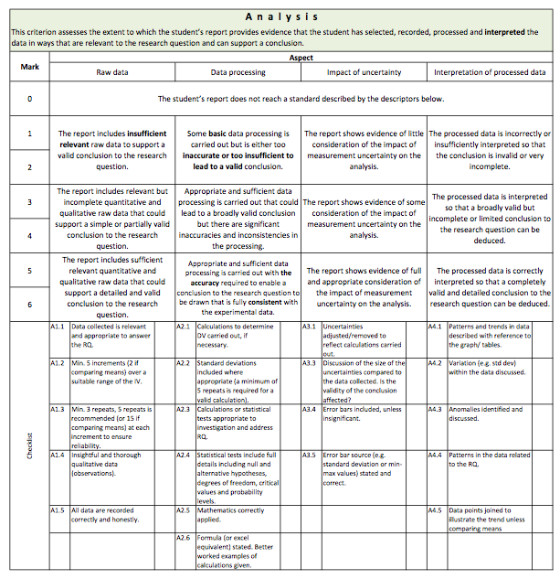
There is a lot of detail! …
… How should I read and use the IA criteria?
http://www.slideshare.net/diverzippy/bioknowledgy-dp-bio-ia-criteria-v11

Slide 3
Let’s break it down – there are 3 parts
3
marks
2
aspects
1
checklists

Slide 4
Let’s break it down
3
Depending on brand you attained in each aspect you will be awarded a mark for the criteria.
2
The checklist helps you to know how well did you do against each aspect
1
The checklist tells you what needs to be in your report*
*The checklist is designed to fit a common approach. Some checks may not be valid for investigations taking an unusual approach.

Slide 5
How does the checklist equate to the aspects?
2
It’s likely that the top band will be awarded
x
1
x
Most checks completed? Maybe just one minor mistake or omission?
x
x
x

Slide 6
How does the checklist equate to the aspects?
2
The band you are awarded depends on:
how many checks are missed
How many minor mistakes are made
How important the major mistakes are
x
1
Some checks completed?
A few minor, or maybe a major mistake or two?
x
x

Slide 7
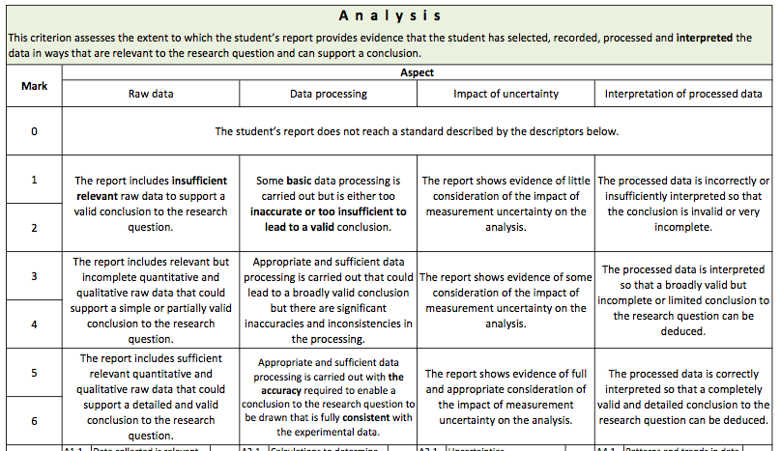
How does the checklist equate to the aspects?
2
Attained the same band in each aspect?
3
Then you should receive the top mark in that band for the criteria

Slide 8
How does the checklist equate to the aspects?
2
Attained a mixture of bands in the different aspects?
3
Then you should receive a mark that ‘best fits’ your
attainment overall.

Slide 9
How does the checklist equate to the aspects?
2
Attained a mixture of bands in the different aspects?
3
The best-fit approach means that sometimes a mark maybe adjusted up or down depending on the particular strength or weakness of a given aspect.

Slide 10
4
Marks for each criteria are added together
1
3
4
4
2
14
58
The overall total counts as 20% of your final grade for the Biology Diploma Exam

