Slide 1

Welcome to with Mrs. Tyler!
Please start filling out your student survey when you find your seat ☺

Slide 2


A little about me…

Slide 3
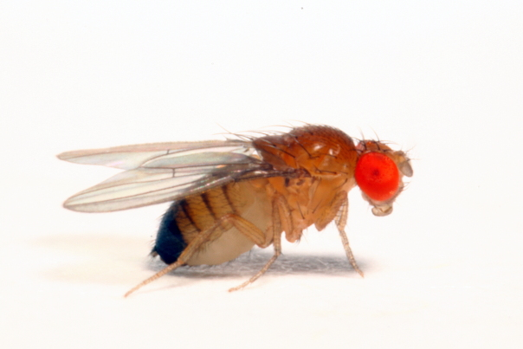
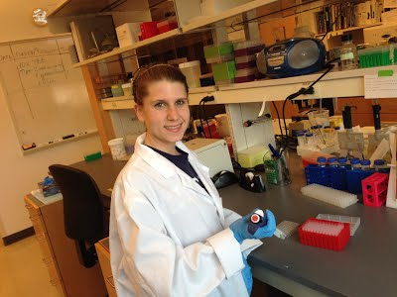
Fly Genetics

Slide 4

Laney High School

Slide 5

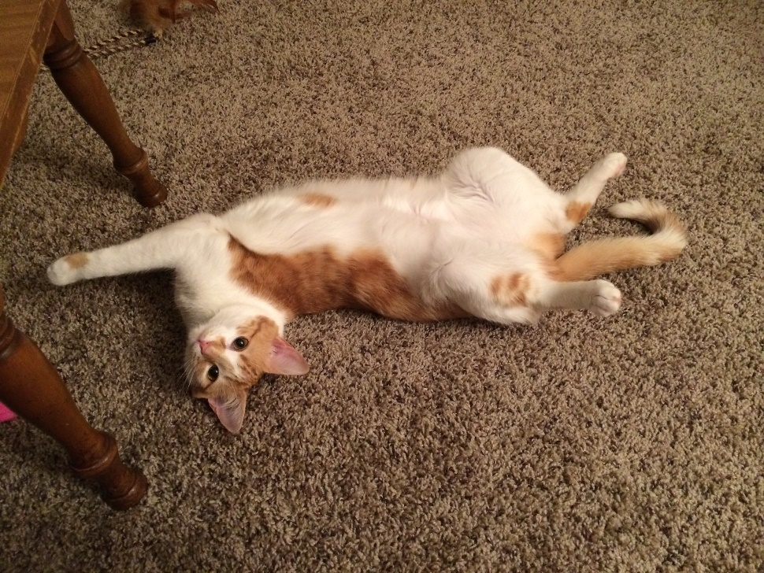
Lucy, Scout & Ella

Slide 6
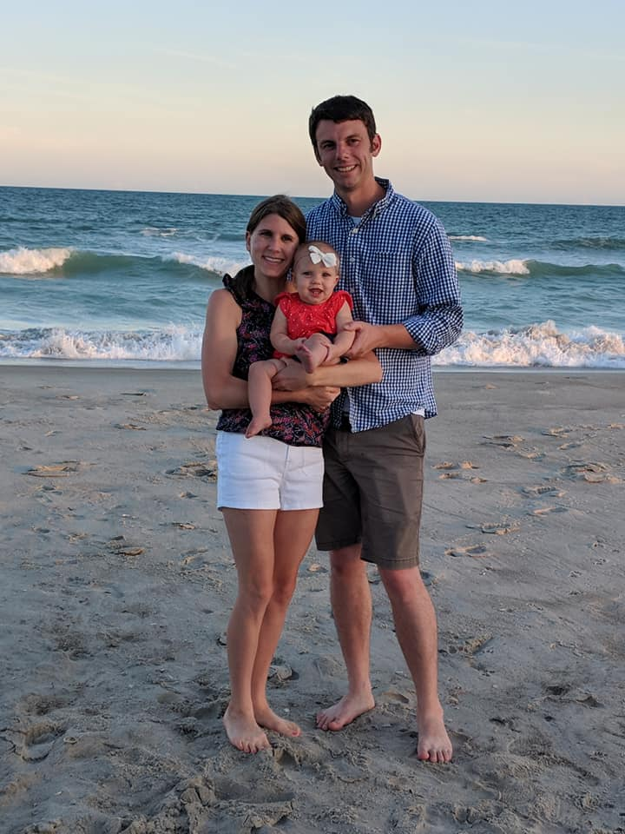
My Family

Slide 7


When I was in High School…

Slide 8
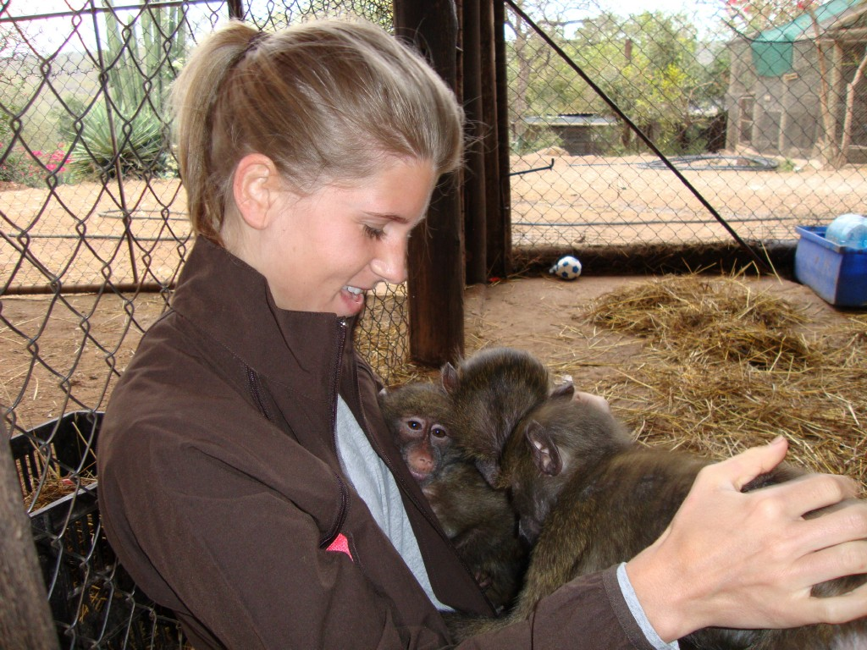
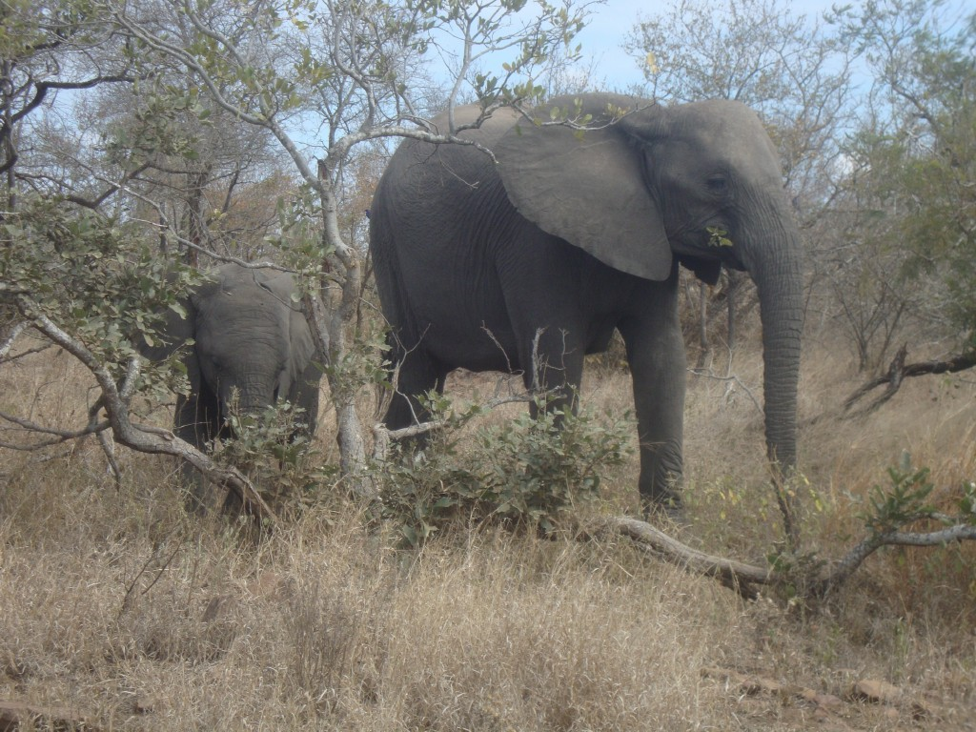
Something Unique

Slide 9






Favorite Things in the World

Slide 10
What is Biology?
What comes to mind?

Slide 11
Course Overview
Topics we will cover throughout this semester:
Scientific Method
Biochemistry
Cells/Cell Membranes
Photosynthesis & Cellular Respiration
DNA, RNA & Protein Synthesis
Cell Division (Mitosis/Meiosis)
Inheritance of Traits (Genetics)
Biotechnology
Evolution
Classification/Animal Behavior
Bacteria/Viruses
Ecology/Human Impact

Slide 12
Syllabus

Slide 13
Required Materials
3-ring binder (1.5 inch or larger)
Dividers (5)
Notebook paper
Blue/black pens
#2 pencils
Recommended:
Colored pencils
Highlighters

Slide 14
Grading – Point System
Tests – 100 points
  Mostly multiple choice with a short answer section
  Can do test corrections
Unit Packets (notes, classwork, bellwork, homework) - 80 – 100 points
  Due on test day
  Homework sentences summarize main points of notes
Labs – 30 - 60 points
Other (quizzes, current events, etc.) - 10 – 20 points
Late Work – 10 points off each class it is late!
If, for any reason, you decide not to participate in class/in a lab, then you will have 5 points deducted from that unit’s classwork grade.
These points are nonrefundable – you cannot get them back.

Slide 15
Sign Up for Remind 1o1
1. Send a text to "81010"
2. The message part of your text should include your class code: @tylerbio(yourblock#)
@tylersci1a
@tylersci2a
@tylersci3a
@tylersci4a
@tylersci1b
@tylersci2b
@tylersci3b
@tylersci4b

Slide 16
Class Website
All PowerPoints, Labs, Handouts, Extra Study Resources, and Class Reminders/Due Dates Posted here!
https://jtylerscience.weebly.com
To access it, type the url or do this:
Go to the Broughton homepage
Click the link at the top labeled ”Our School”
Click on “Staff Directory”
Find my name and click on website link

Slide 17
Classroom Expectations
Be on time to class
Be prepared with needed materials
Participate in the assigned activities
Show respect for your classmates, teacher, lab equipment, and safety guidelines at all times
Have a positive attitude about learning, and ask questions!

Slide 18

Electronics Policy
There is a strict NO CELL PHONE or EARBUD POLICY!!!!
WHY?
If you are using your phone I will ask you politely to put it on my desk. If you comply then you will get it back at the end of class
If you refuse it is an instant referral.

Slide 19
Classroom Procedures
Starting Class
-Pick up papers for the day on cart near the door
-Sit quietly and complete your bellwork
-Get homework out to turn in
Makeup Work
-Classwork- turned in within 2 class periods of your absence
-Tests- taken within 2 days of your absence
-Work that was due on the day of your absence is due the day you come back

Slide 20
Classroom Procedures
Bathroom
  2 passes per quarter.
  ASK PERMISSION, fill out the folder, take the pass, 5 minutes to hurry back!
Getting out of your seat
  Pencil sharpening, trash, etc. should be taken care of in between activities, not in the middle of a lesson

Slide 21
Remember
It is ok if you don’t get things the first, second or even third time, but it is NOT ok to not try
You WILL get it! I believe in you!
Ask for help from me, from peers…
My tutoring days:
Tuesdays and Thursdays (2:20-3:30)
  By appointment if notified in advance

Slide 22
Academic Integrity
I have the expectation that everyone in this class will work to the best of their ability.
Cheating will not be tolerated. This includes copying ANY assignment, allowing someone to copy your work, using written notes on tests/quizzes, talking/texting during assessments, etc.
Cheating = NO CREDIT

Slide 23
Tips for Success ☺
Always come to class with a positive attitude
Participate in class
Don’t be afraid to make mistakes
Take good notes during class; highlight key ideas
Spend a minimum of 15 minutes every night reviewing classwork and notes
Do your homework for extra practice
Don’t hesitate to ask for help

Slide 24
Set a Class Goal
What do YOU personally want to accomplish this semester?
What do WE as a class want to accomplish this semester?

Slide 25

Welcome Activity!

